Slide 1

Java advanced
Building a GUI using the JavaFX API
Laatste 10 minuten voor vragen.
Workshop @ InfoSupport op 20 maart
Volgende lessen

Slide 2
The Use Case
What we will learn
Analyze requirements
UX/UI Design
Introduction to JavaFX
The Stage , Start a new Application, The scene graph, Node types, Class Structure, Event handling, Property Binding, Scalable Vectors, Transformations, Object mapping

Slide 3
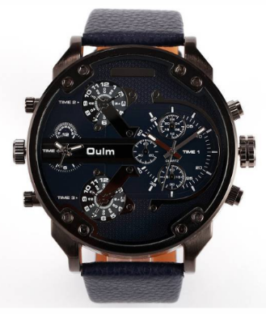


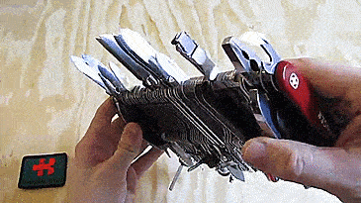
The Use Case
The programmatic equivalent of a multifunction wrist watch and a Swiss army knife
While not possible with the watch or the knife, you will be able to extend our application
Richard Dean Anderson

Slide 4
The Use Case
An analog clock that can do much more than just indicating the time
It should be able to work also as
an academic calendar providing a graphical overview of the upcoming exams
an agenda merging the appointments from several sources
a media player to play the favourite podcasts
...

Slide 5
What we will learn
Perform a functional and technical analysis dedicated to a GUI
Create a class structure and so-called scene graph that answers the requirements
Explore the different types of elements that can be added to application
Use different approaches to lay out visual elements on the screen
Implement event handlers

Slide 6
A JavaFX application step-by-step
Analyze requirements
UX/UI Design
Design a scene graph
Build a class structure
Implement the scene
Attach event handlers
Test the application
There are several approaches to building a JavaFX application
Especially the order of events may differ
Approaches may differ dependent on type of application, demand, other parts of the application or personal preferences

Slide 7
Analyze requirements
A small gadget; like a (smart) sticky note on your screen...
A widget that I can easily expand
As with most applications, a quality product starts with a profound analysis of the user requirements.
Typically, UI’s give you more degrees of freedom than when implementing pure business logic.
Those extra degrees of freedom you have can be a blessing (‘you do what you want’) but frequently they are also the cause of failing projects (‘because maybe the user wanted something else...’)
Something that helps me organize time
I want to have a media player on it to play my favorite podcasts
It shows me visually how long to the next exams

Slide 8
UX/UI Design Introduction
Indicates current date
Overlay new functionality such as academic calendar
Change
skin
We will not be able to cover all functional requirements in this tutorial, but
We need to consider the extensibility of the application from the start (see architecture course)
Control
appearance
of all visual elements
exam period indicated in red
Should be
resizable
Add panel to the right when clicking AP logo
Double clicking on panel rotates functionality of panel

Slide 9
UX/UI Design The functionality of the window
click
click
click
click
4
Screen
1
click
Circular in shape
Resizable (ctrl +/-)
Sticks to a corner of the screen
Upon double click rotates to next corner clockwise (default = top right)
Side pane expands upon click on element (the AP logo)
CTRL
+
-
click
click
click
click
3
2
click
click
click
click
4
Screen
1
click
3
2
click
click
click
click

Slide 10

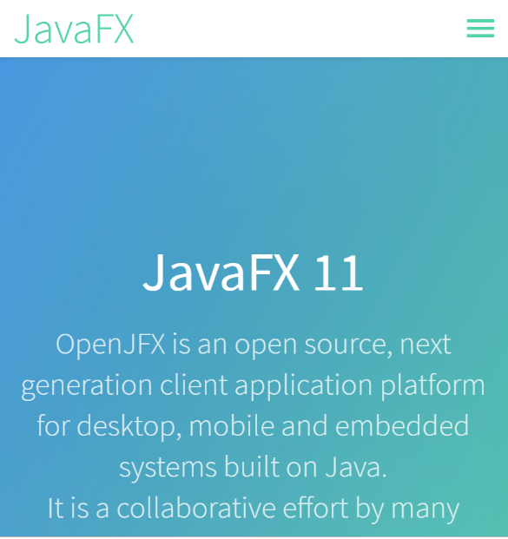
Before we get started, a quick Introduction to
Website: https://openjfx.io

Slide 11
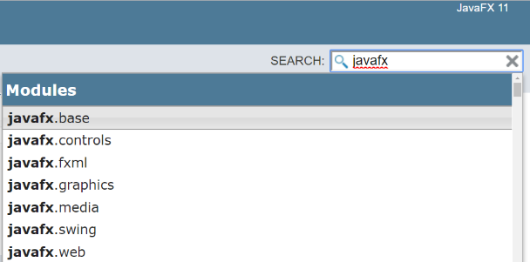
Before we get started, a quick Introduction to modules
In the documentation, type in javafx to list all the currently available modules
javafx.base: base APIs for bindings, properties, collections, and events.
javafx.controls: UI controls, charts, and skins
javafx.fxml: FXML APIs (see later)
javafx.graphics: core scenegraph APIs
javafx.media: playback of media and audio content
javafx.swing: JavaFX / Swing interop support
javafx.web: WebView functionality

Slide 12

The Stage
Title bar,
title,
border,
close button,
etc...
= decorations
y
Successor of Java Swing API’s
Serves to build Desktop application or RIA’s (Rich Internet Applications)
You can find the documentation here: https://openjfx.io/javadoc/11/
The superclass from which all JavaFX applications must extend is the javafx.Application class
A JavaFX application consists of stages, scenes and scene graphs (see left)
x
The scene contains all JavaFX elements. It can be either 2D or 3D.
Label is leaf node
The root node = Parent node
An application can have multiple stages open simultaneously
A scene graph is e hierarchical collection of nodes (see later)
stage is like a window

Slide 13
The Stage
Stage
Successor of Java Swing API’s
Serves to build Desktop application or RIA’s (Rich Internet Applications)lass
You can find the documentation here: https://openjfx.io/javadoc/11/
The superclass from which all JavaFX application must extend is the javafx.Application class
A JavaFX application consists of stages, scenes and scene graphs (see left)
Scene
Root node
Parent Node
Leaf Node
Leaf Node
Leaf Node
Scene graph
Parent Node
Leaf Node
Leaf Node

Slide 14
The Stage
The stage is the window
Multiple stages possible but at least one = primary stage
It can have different styles (see left)
It takes care of
xyz positioning
maximizing/minimizing
prepare event handlers
displaying (show) or hiding (hide) the window
icon
Decorated
Undecorated
Transparent
Utility

Slide 15
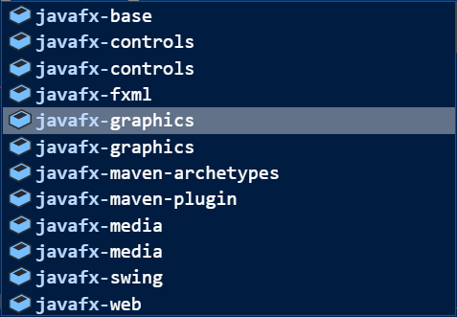
Start a new Application Steps to get started with a new JavaFX application
> mvn compile exec:java
public class Timesup extends Application {
public static void main(String[] args) {
launch(args);
}
@Override
public void start(Stage stage) {
stage.show();
}
}
...
<build>
<pluginManagement>
<plugins>
<plugin>
<groupId>org.codehaus.mojo</groupId>
<artifactId>exec-maven-plugin</artifactId>
<version>1.6.0</version>
<executions>
<execution>
<goals>
<goal>java</goal>
</goals>
</execution>
</executions>
<configuration>
<mainClass>be.ap.javadv.javafx.Timesup</mainClass>
</configuration>
</plugin>
</plugins>
</pluginManagement>
</build>
...
...
<dependency>
<groupId>org.openjfx</groupId>
<artifactId>javafx-controls</artifactId>
<version>11.0.2</version>
</dependency>
<dependency>
<groupId>org.openjfx</groupId>
<artifactId>javafx-graphics</artifactId>
<version>11.0.2</version>
</dependency>
...
New Maven project
In the POM.xml file:
Add dependencies
Add Maven compiler’s entry point
Add main class
Note how the class extends the Application superclass
Note the use of the launch method
Start application
Starting the JavaFX Application Thread!
demo
javafx_00

Slide 16

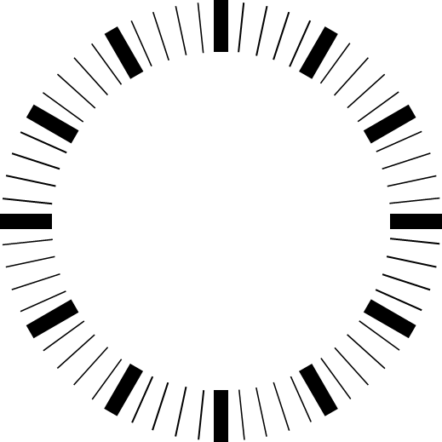
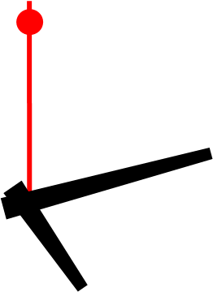

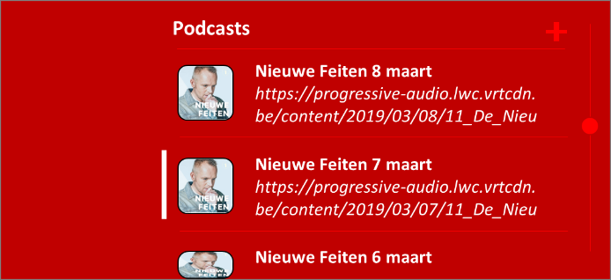
The Scene Graph
Podcasts
JAN
DEC
13
FEB
Nieuwe Feiten 8 maart
https://progressive-audio.lwc.vrtcdn. be/content/2019/03/08/11_De_Nieu
monday
NOV
march
MAR
A Scene contains the scene graph
The scene graph (as in graph theory) is a hierarchical collection of (visual) JavaFX elements (the nodes of the graph)
The nodes of the graph correspond one-to-one with the elements that result from the functional analysis
OCT
APR
Nieuwe Feiten 7 maart
https://progressive-audio.lwc.vrtcdn. be/content/2019/03/07/11_De_Nieu
SEP
MAY
AUG
JUL
JUN
Nieuwe Feiten 6 maart
logo
date
handles
dial
tick marks
back
side pane

Slide 17
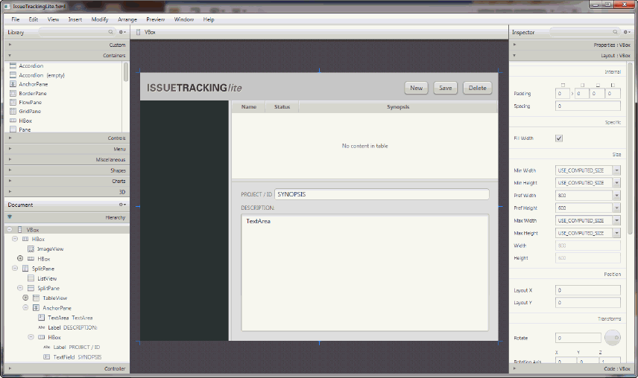
Several options to make The Scene Graph
1.
Rectangle back = new Rectangle(
0, 0,
PANE_WIDTH - SPACING,
SIZE - 2 * SPACING);
Programmatically:
Full control on initialization and use of objects
Using a scene builder tool such as Oracle’s Scene Builder
Can become too contstraining
A bit slower to build
Can be faster to develop
2.

Slide 18
Let’s get started with making The Scene Graph
@Override
public void start(Stage stage) {
Font font = new Font ("Arial", 72);
Label text = new Label("TRANSPARENT");
text.setFont(font);
text.setTextFill(Color.WHITE);
Group group = new Group(text);
Scene scene = new Scene(group);
scene.setFill(Color.TRANSPARENT);
stage.setScene(scene);
stage.initStyle(StageStyle.TRANSPARENT);
stage.centerOnScreen();
stage.show();
}
easy to reuse font variable elsewhere
(separation of concerns)
primary stage
Here is a fun example of a very simple application which stage consists entirely of the label that says ‘TRANSPARENT’
Note how mouse events can pass through the transparent parts of the stage
imports from javafx.scene.control
setting the label properties
Root node of scene graph
link scene with primary stage
demo
Make stage visible
javafx_01

Slide 19

What are they and what do they want Nodes
Each item in the scene graph is called a Node
Nodes can be leaf nodes or branch nodes
The one and only top node is called the root node
Branch nodes are of type Parent (Group, Region, Control and subclasses thereof)
Leaf nodes have no children and are classes such as Rectangle, Text, ImageView, MediaView
A node may occur at most once anywhere in the graph (acyclic)
It is OK to detach a branch from a graph and attach it ot another graph
Node attachment must occur on the JavaFX Application Thread

Slide 20



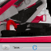
Exploring Node types
Node
Camera
ParallelCamera
PerspectiveCamera
Canvas
ImageView
LightBase
PointLight
AmbientLight
MediaView
Parent
Shape
Shape3D
Subscene

Slide 21

Parent
Node
Parent
Group
Region
Axis
CategoryAxis,
ValueAxis
Chart
Control
Pane
TableColumnHeader
NestedTableColumnHeader
VirtualFlow
WebView

Slide 22
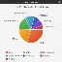
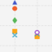
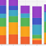
Chart
Node
Parent
Region
Chart
PieChart,
XYChart
AreaChart,
StackedAreaChart
ScatterChart
StackedBarChart
LineChart
BubbleChart
BarChart

Slide 23
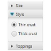
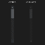

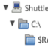
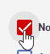
Control
Parent
Region
Control
Accordion
ScrollPane
ButtonBar
Separator
ChoiceBox
Slider
ComboBoxBase
Spinner
HTMLEditor
SplitPane
Labeled
TableView
ListView
TabPane
MenuBar
TextInputControl
Pagination
ToolBar
ProgressIndicator
TreeView
ScrollBar
TreeTableView

Slide 24
Labeled
Region
Control
Labeled
ButtonBase
Button
CheckBox
Hyperlink
MenuButton
SplitMenuButton
ToggleButton
RadioButton
Cell
Label
TitledPane

Slide 25
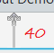
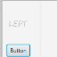
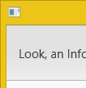
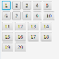
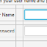

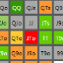
Pane
Pane
AnchorPane
BorderPane
DialogPane
FlowPane
GridPane
HBox
PopupControl.CSSBridge
StackPane
TextFlow
TilePane
VBox

Slide 26

Shape
Node
Shape
Rectangle
Circle
Polyline
CubicCurve
QuadCurve
SVGPath
Text
Arc
Ellipse
Path
Line
Polygon

Slide 27
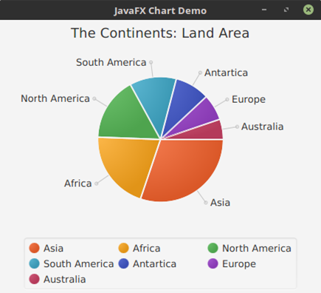
PieChart

Slide 28
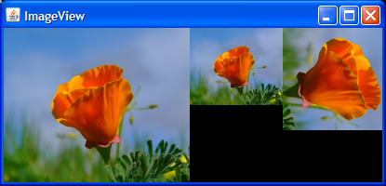
ImageView

Slide 29
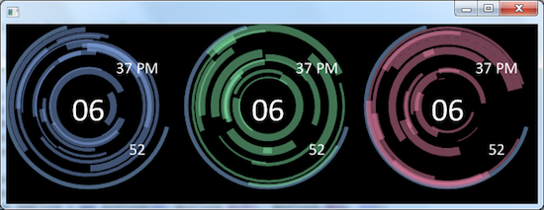
Canvas

Slide 30
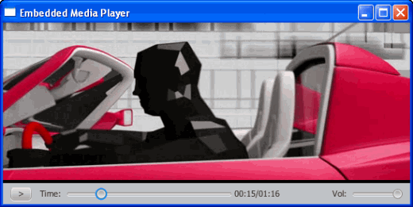
MediaView

Slide 31
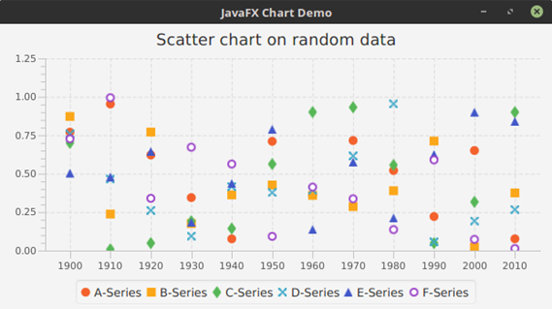
ScatterChart

Slide 32
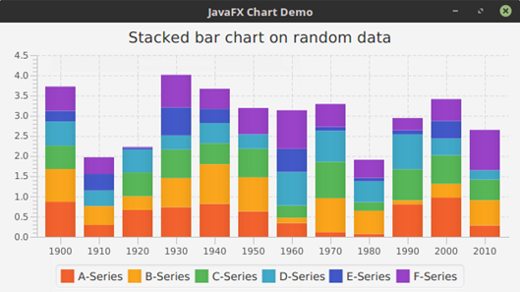
StackedBarChart

Slide 33
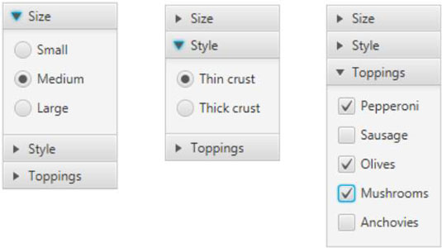
Accordion

Slide 34
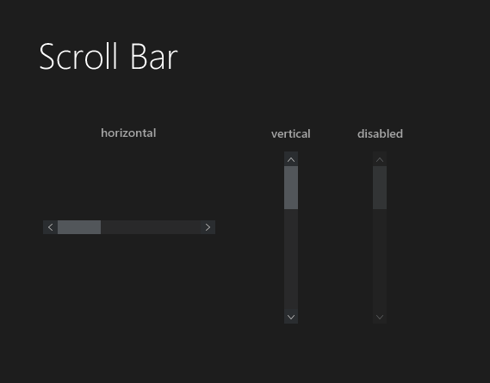
Scrollbar

Slide 35
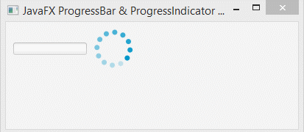
ProgressIndicator

Slide 36
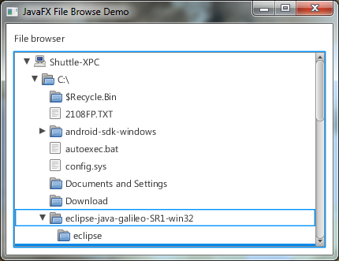
TreeView

Slide 37
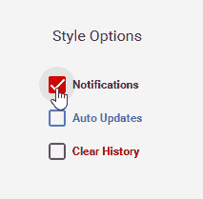
CheckBox

Slide 38

WebView

Slide 39
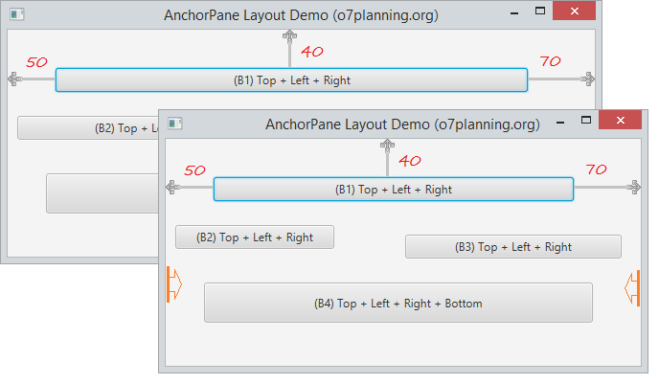
AnchorPane

Slide 40
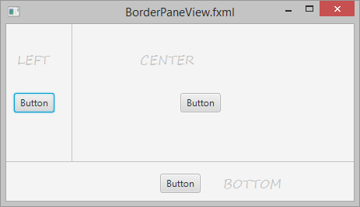
BorderPane

Slide 41
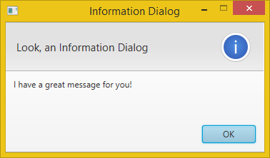
DialogPane

Slide 42
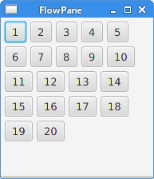
FlowPane

Slide 43
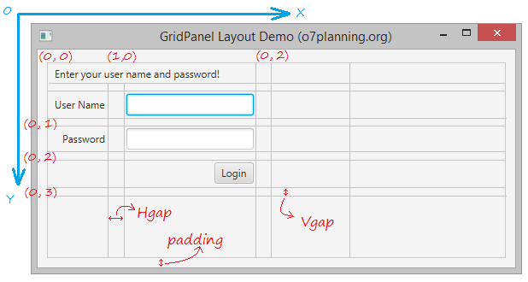
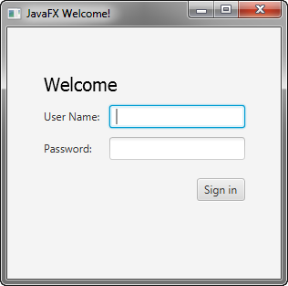
GridPane

Slide 44
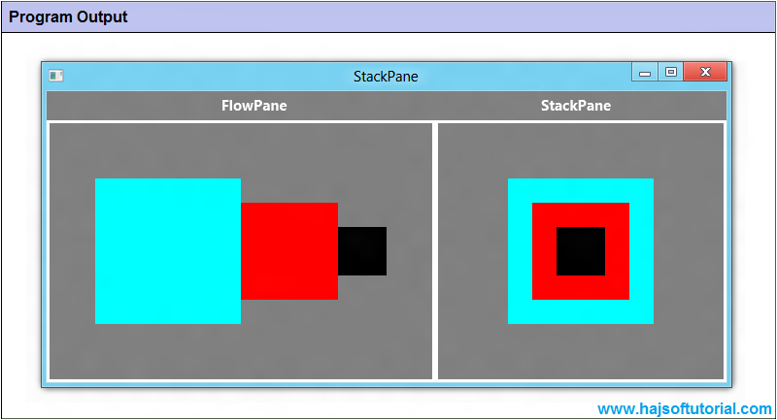
StackPane

Slide 45
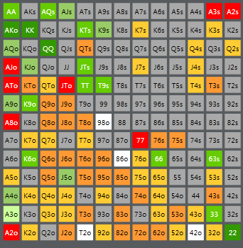
TilePane

Slide 46
Deciding on Class Structure
SidePane.java
Clock.java
Position.java
SidePane.java
Timesup.java
StackPane sidePane
Rectangle background
logo
Clock.java
demo
javafx_02

Slide 47
Event handling For moving the position of the stage
clock.setOnMouseClicked(
e->{
if (e.getButton().equals(MouseButton.PRIMARY) &&
e.getClickCount() == 2) {
moveStageToNextPos();
}
}
);
...
clock.setOnMouseClicked(onDoubleClick());
...
private EventHandler<MouseEvent> onDoubleClick() {
return new EventHandler<MouseEvent>() {
@Override
public void handle(MouseEvent mouseEvent) {
if (mouseEvent.getButton().equals(MouseButton.PRIMARY) && mouseEvent.getClickCount() == 2) {
moveStageToNextPos();
}
}
};
}
Upon double clicking, the stage needs to move to the next position, the next corner of the screen
This can be achieved among others by using an anonymous inner class that implements the EventHandler <MouseEvent> and overrides the handle method...
or using a lambda expression!

Slide 48
Property binding
Previous case is for “if user does this then run that method” situations but what if we want to bind the state of a node to a variable that is continuously being monitored?
In our case we define a variable sidePaneVisible and want change the visibility of the side pane based on this variables value, irrespective of who is changing it
This way, the programmer only needs to worry about setting the variable
sidePaneVisible
Several processes may influence the state of the variable

Slide 49
Property binding
public static BooleanProperty sidePaneVisible =
new SimpleBooleanProperty(false);
sidePane.visibleProperty().bind(sidePaneVisible);
sidePaneVisible.addListener(
(arg, oldVal, newVal) -> {
if (newVal) {
stage.setWidth(ClockStyle.RADIUS + ClockStyle.PANE_WIDTH);
} else {
stage.setWidth(ClockStyle.DIAM);
}
Clock.setPos(Clock.getPos());
}
);
...
view.setOnMouseClicked(e -> {
sidePaneVisible.set(!sidePaneVisible.getValue());
});
First, bind the visibility property of the node to the variable
Then define the change listener using a lambda expression
Now, all you need to do is to change the variables to trigger the downstream events
In order for property binding to work you need to use observable variables of the javafx.beans.property package
SimpleBooleanProperty implements ObservableBooleanValue which inherits from superinterface Observable
Interesting: we will also use observable collections to update a ListView

Slide 50
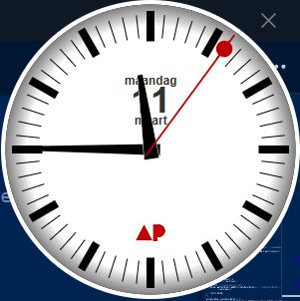
Scalable Vectors
Circle border = new Circle(ClockStyle.RADIUS,
ClockStyle.RADIUS, ClockStyle.RADIUS);
Line tick = new Line();
There are at least two approaches to adding scalable shapes in your application:
Create the shapes individually from the Shape or Shape3D classes (OO)
Reading the shape-files from other serialized format such as SVG
SVGPath handPath = new SVGPath();
handPath.setContent(getHandPath("SimpleHand"));
demo
javafx_03

Slide 51
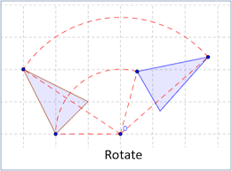
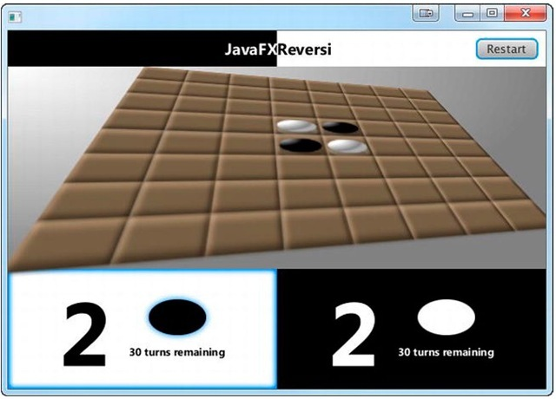
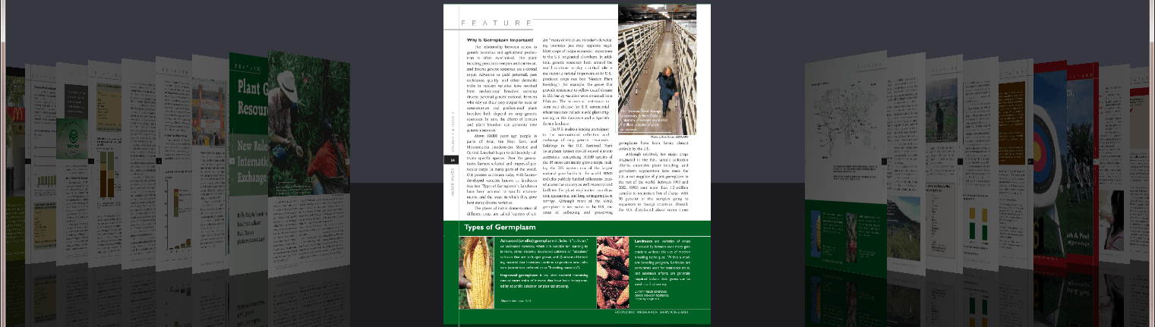
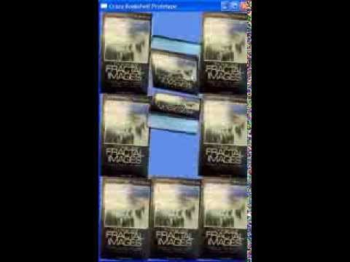
Transformations
We used trasnformations to rotate the handles of the clock
The following transformations are available out-of-the-box (from javafx.scene.transform):
Affine
Rotate
Scale
Shear
Translate

Slide 52
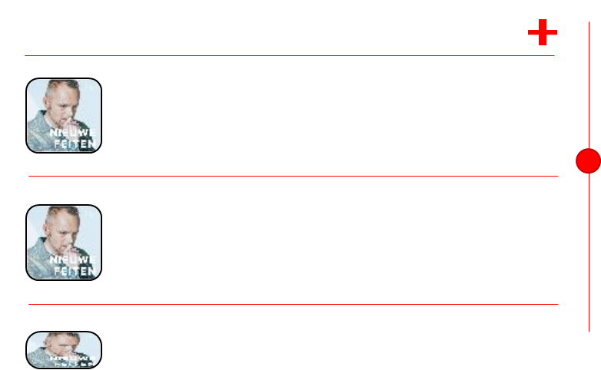
The Application - SidePanel
StackPane sidePane
Rectangle background
Group podcastPane
PodcastPane.java
SidePane.java
logo
PodcastCell.java
(extends ListCell<Podcast>)
binding
PodCast.java
Clock.java
demo
javafx_04

Slide 53
The Application – PodcastPane
Group
VBox vBox
HBox titleBox
Label title
Pane spacer
Label plusSign
Line spacerLine
ListView<Podcast> podCastListView
ListCell<Podcast> PodcastCell
Grows in given direction to fit content of parent

Slide 54
The Application - ListView/ListCell
final ListView<Podcast> podCastListView = new ListView<Podcast>(this.data);
podCastListView.setCellFactory( new Callback<ListView<Podcast>, ListCell<Podcast>>() {
@Override
public ListCell<Podcast> call(ListView<Podcast> listView) {
return new PodcastCell();
}
}
); @Override
protected void updateItem(Podcast item, boolean empty) {
super.updateItem(item, empty);
if (item != null && !empty) {
this.title.setText(item.getTitle());
this.url.setText(item.getUrl());
this.image.setImage(new Image(item.getImage())); setGraphic(content); } else {
setGraphic(null);
}
}
Upone creation of the listview, define a callback that serves as factory method to create the cells of the listview
In the corresponding class that representss the cell of the list view, override the updateItem method and map the fields of the object to the properties of the ListCell

